Slide 1

Speech Command Classification
Team 5
Lee Dong ho, Jin Chang Ho, Jung Jae Yoon
Team 5

Slide 2




Contents
Description of Dataset
Training methods
Description of the model
Experiment
Result
Tensorflow Model
https://colab.research.google.com/github/tensorflow/docs/blob/master/site/en/tutorials/audio/simple_audio.ipynb
Our Model
https://colab.research.google.com/drive/1DkhJiNiRlY8czFBjL28K-WxdUI3pxHRp?usp=sharing
Team 5
2

Slide 3
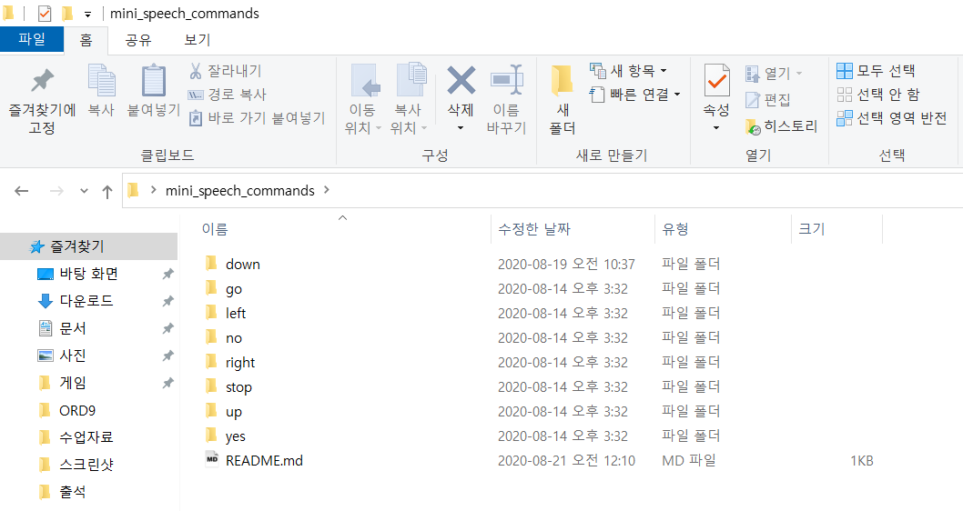
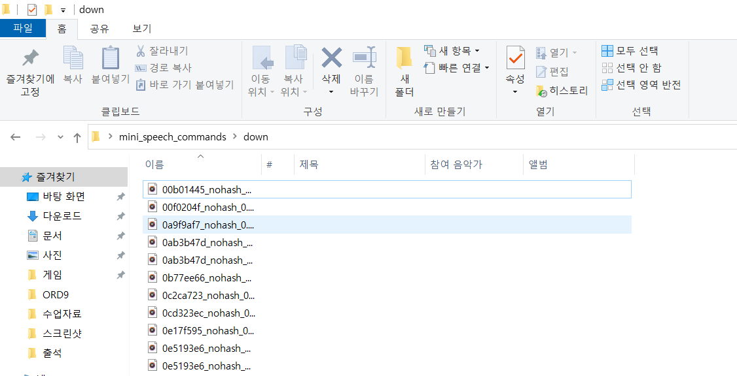
Description of Dataset
mini_speech_commands
Category : yes / no / right / stop / go / up / left / down
1000 wav files for each category -> Total 8000 wav files
6400 wav files for training, 800 wav files for validation,
800 wav files for test
Download link : http://storage.googleapis.com/download.tensorflow.org/data/mini_speech_commands.zip
Team 5
3

Slide 4
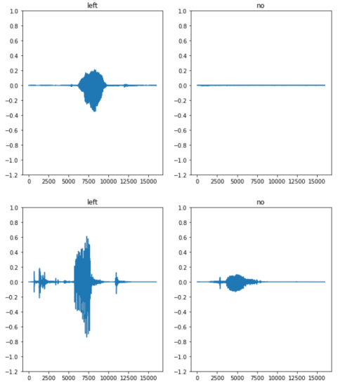
Training methods (1/2) (Tensorflow)
Reading audio file & label
Audio file : binary file -> float32 tensor
Label : string tensor
Ex) left, no, yes etc..
Use (Audio file, Label) Dataset
-
It shows labels and normalized audio files.
x axis: time, y axis: amplitude
Team 5
4

Slide 5
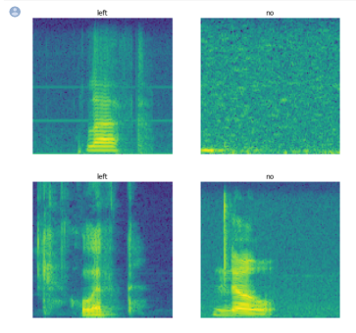
Training methods (2/2) (Tensorflow)
Spectrogram
Audio file -> STSF -> Spectrogram
Some time information and 2D tensor
Use only magnitude
Use zero padding -> Fixed time information
-
It shows labels and spectrogram
x axis : time, y axis : frequency
Team 5
5

Slide 6
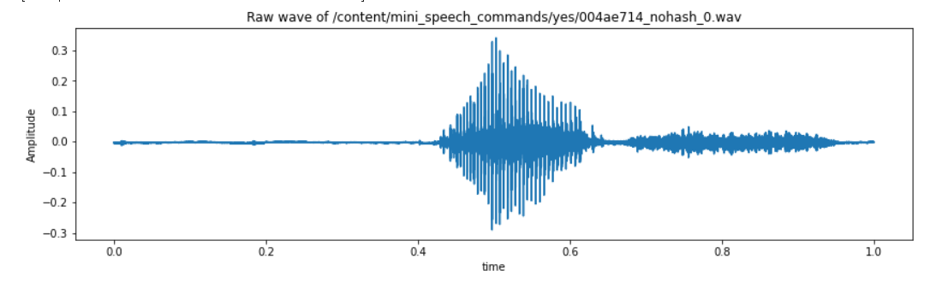
Training methods (1/2) (Our Model)
Reading audio file & label
Audio file : binary file -> float32 tensor
Label : string tensor
Ex) left, no, yes etc..
Use (Audio file, Label) Dataset
x axis: time, y axis: amplitude
Team 5
6

Slide 7
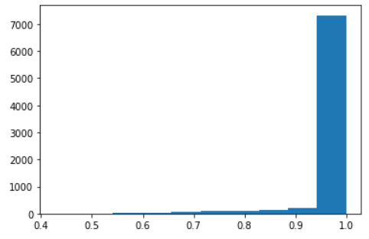
Training methods (2/2) (Our Model)
Preprocessing
duration of a few recordings is less than 1 second
sampling rate is too high.
Resampling, Removing shorter commands of less than 1 second.
x axis : duration, y axis : number of...
Team 5
7

Slide 8
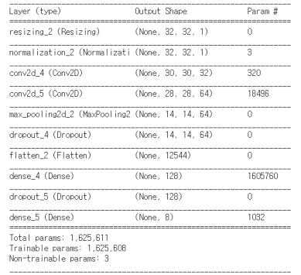
Description of the model (Tensorflow)
Model composed of multiple layers(Conv2d, MaxPooling2d, Flatten, Dense...)
Used keras API
Team 5
8

Slide 9
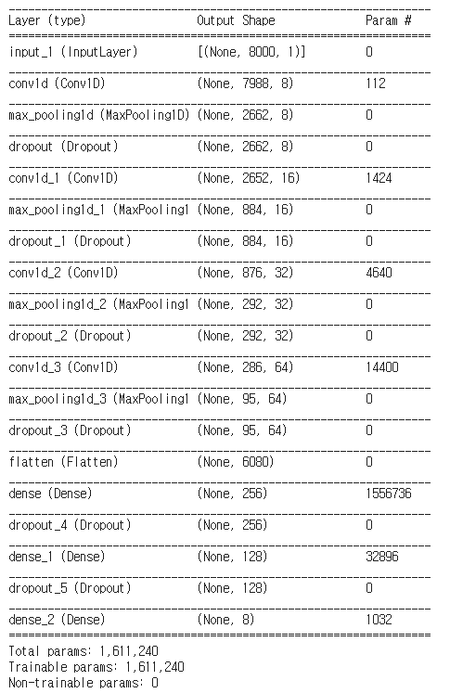
Description of the model (Our Model)
Model composed of multiple layers(Conv1d, Maxpooling, Dropout, Dense, Flatten...)
Used keras API
Team 5
9

Slide 10
Experiment (Tensorflow)
EPOCH
EPOCH | 5 | 10 | 15 | 20 | 25
Accuracy | 80% | 84% | 86% | 85% | 87%
Stop at 5
Stop at 3
Stop at 3
Conv2D(x, 3)
x’s max | 32 | 64 | 96 | 128 | 160
Accuracy | 69% | 84% | 87% | 88% | 88%
Resizing(x, x)
x’s max | 8 | 16 | 32 | 64 | 128
Accuracy | 54% | 75% | 84% | 85% | 79%
x is just variable
Team 5
10

Slide 11
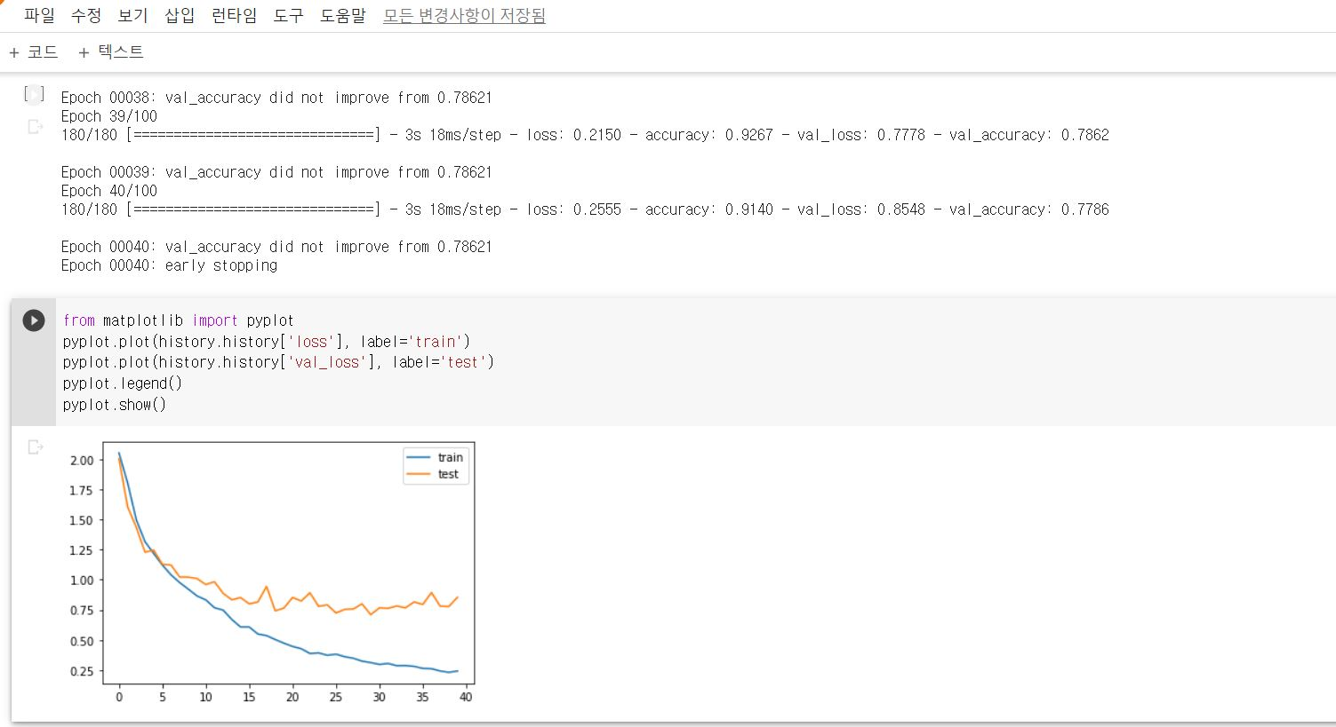
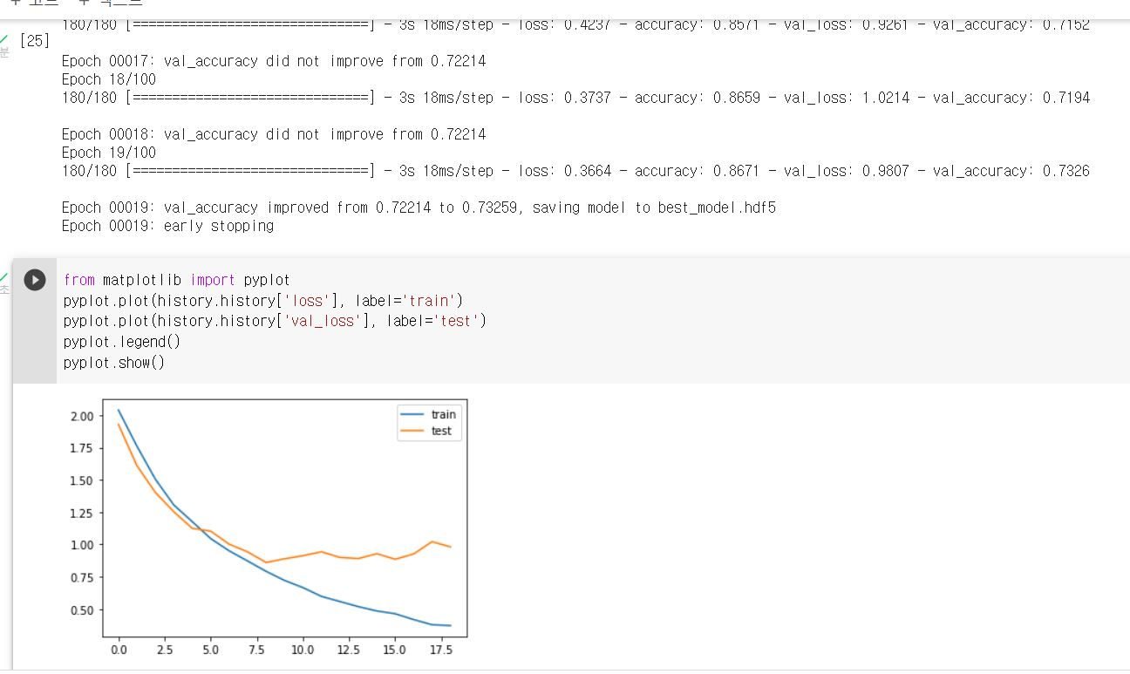
Experiment (Our model)
Original model
78.6%
Dropout 0.3 -> 0.2
73.2%
Team 5
11

Slide 12
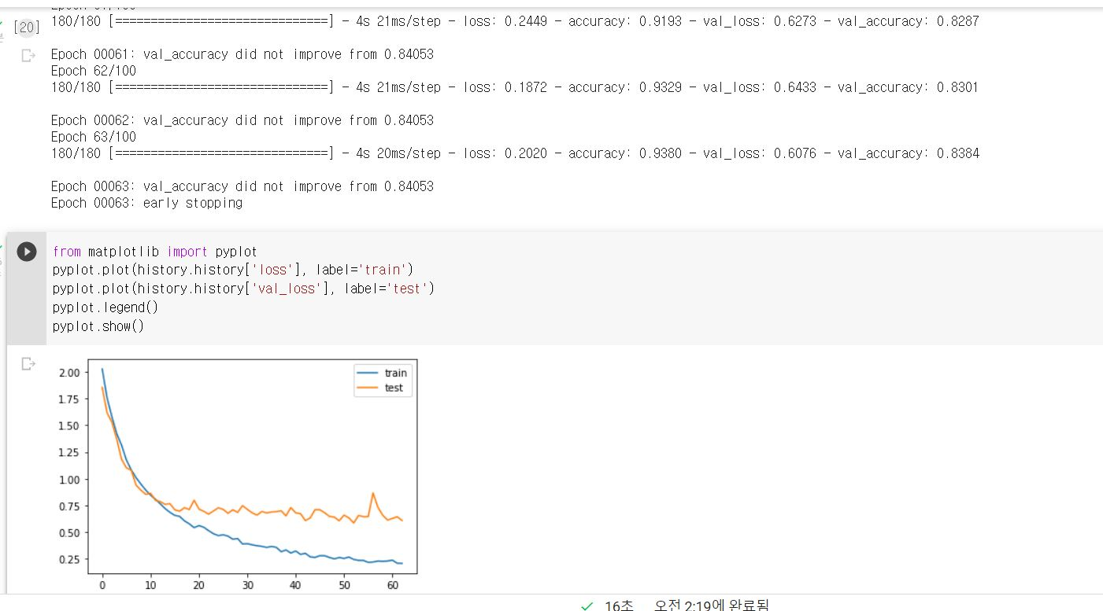
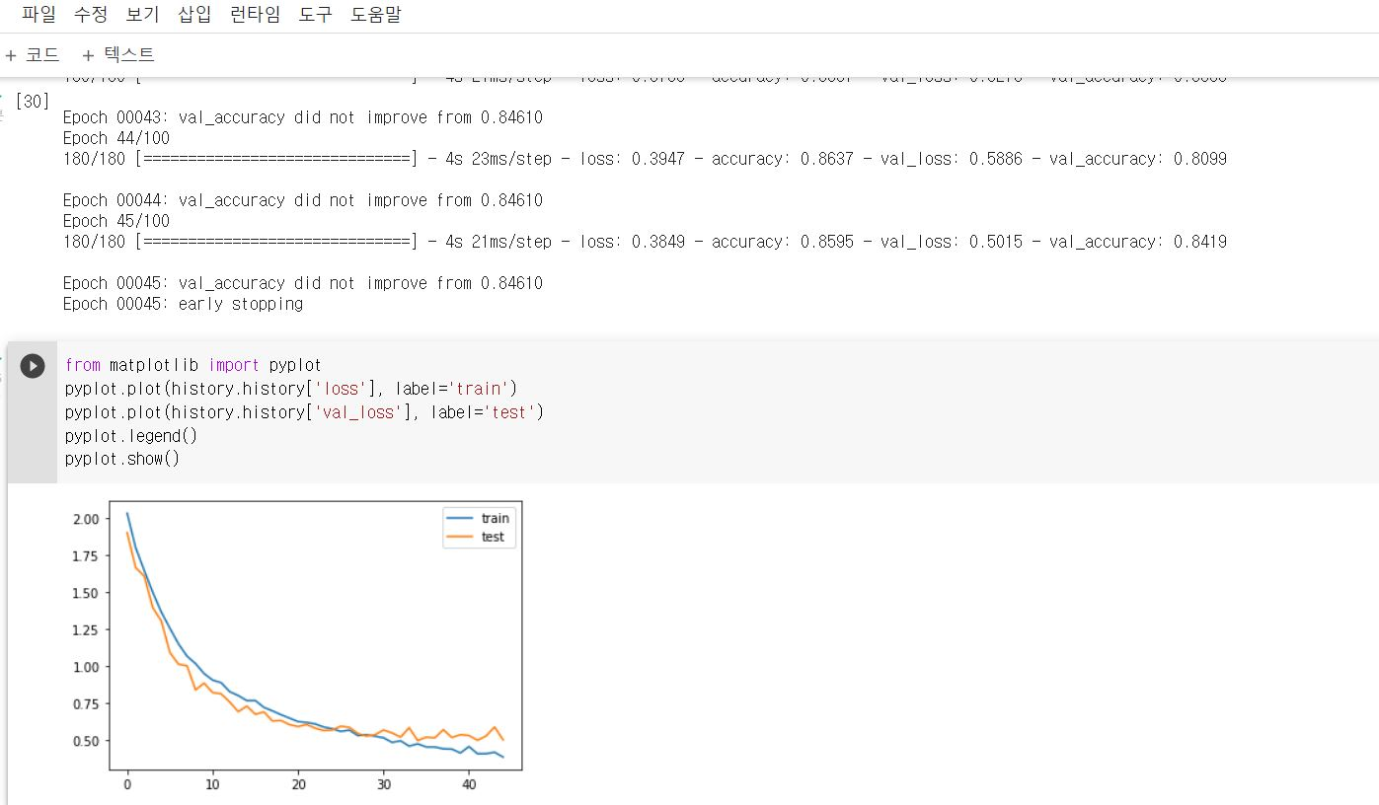
Experiment (Our model)
Add 1 layer
84.0%
Add 2 layers
84.6%
Team 5
12

Slide 13
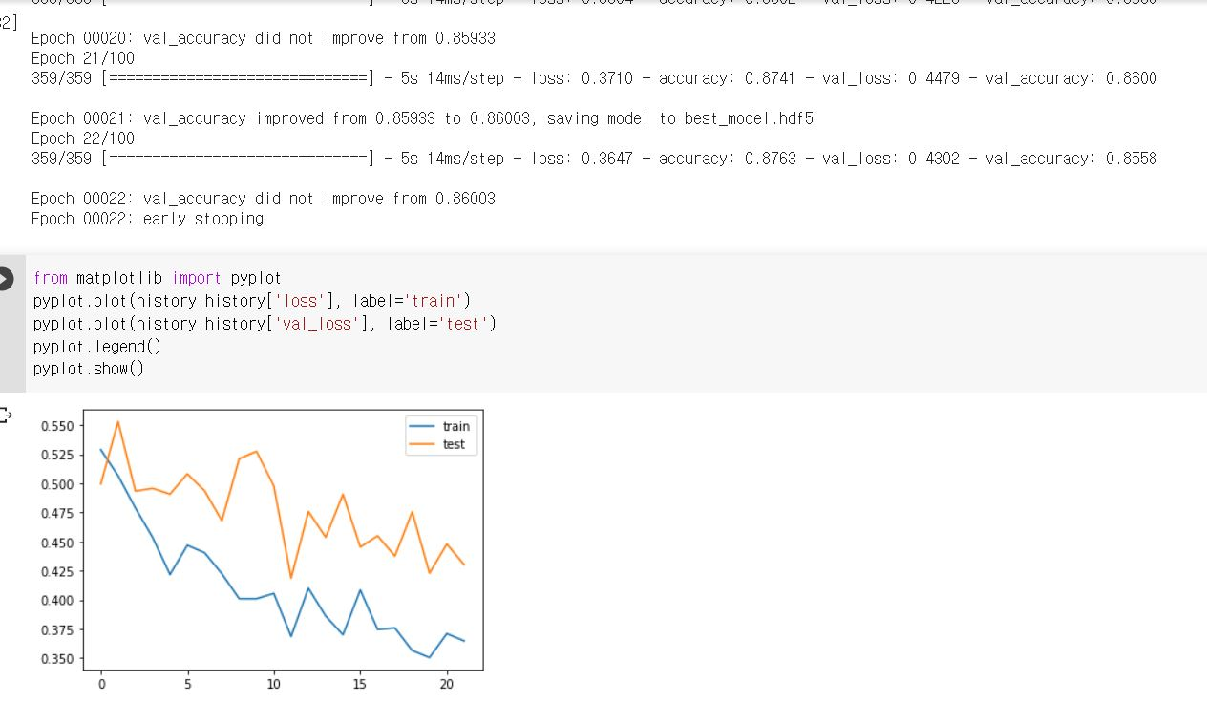
Experiment (Our model)
Add 2 layer, Batch size 32->16
86.0%
Team 5
13

Slide 14
Result (Tensorflow)
How can we make precise model?
Based on the results of the experiment...
1. EPOCH : the larger EPOCH, the more accurate. However, does not matter of accuracy if it is more than 15.
2. Conv2D (x, 3) : the larger x, the more accurate. However, does not matter of accuracy if it is more than 128.
3. Resizing(x, x) : As x increases, the accuracy increases rapidly, but the accuracy decreases certain value between 64 and 128.
x is just variable
Team 5
14

Slide 15
Result (Our model)
How can we make precise model?
Based on the results of the experiment...
1. Layers : Accuracy got higher when we added more layers. However, there was little increase in accuracy when there were more than seven layers.
2. Dropout : When we changed dropout value to more or less than 0.3, accuracy decreased.
3. Batch size : When we reduced the batch size from 32 to 16, accuracy increased but the loss graph got jagged.
Team 5
15

